Slide 1
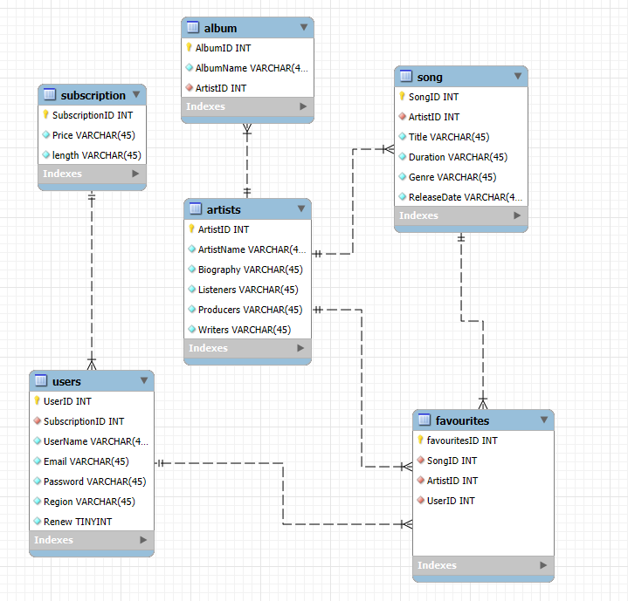
SQL Group Project
An Overview into the process

Slide 2
Project Aims
This project is a group task centred around reverse engineering a MYSQL relational database for a business of our choice, creating each and every table and dictating their relationships in a speculative manner while factoring in important concepts such as data redundancy and normalisation in order to create the skeleton of a database fit to process even big data.
For our project, we decided to try our hands with reverse engineering a database for a music streaming company that provides varying subscriptions for people to listen to and publish music, keeping track of millions of songs, customers and artists and linking these tables together in ways that allow us to collect data such as what artists and genres are popular in certain countries, for instance, and the most listened to and followed songs and artists worldwide.

Slide 3
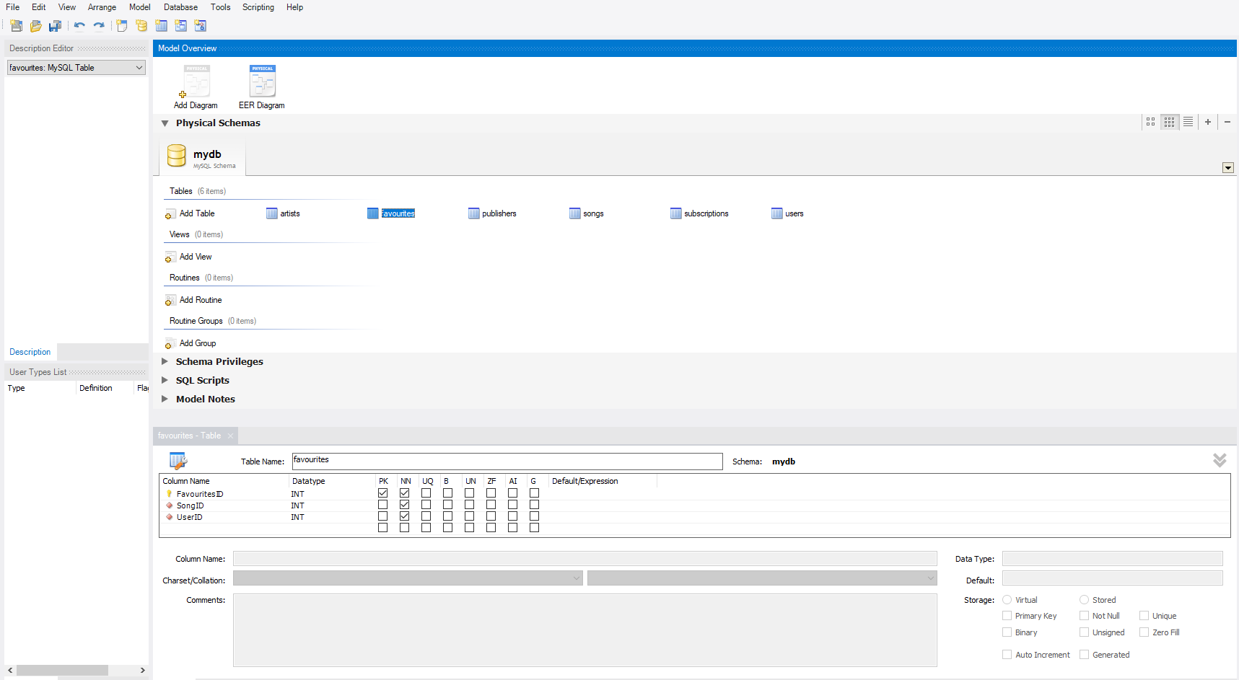
Reverse Engineering
MYSQL allows me to reverse engineer databases from the ground up, creating tables, adding fields for those tables and making sure they seek the correct value, whether that is a Boolean value, an Integer or a VARCHAR value. Doing this now is useful as it saves a lot of time with the ETL process later on, as we already have the fields we wanted and they are in the correct format.

Slide 4
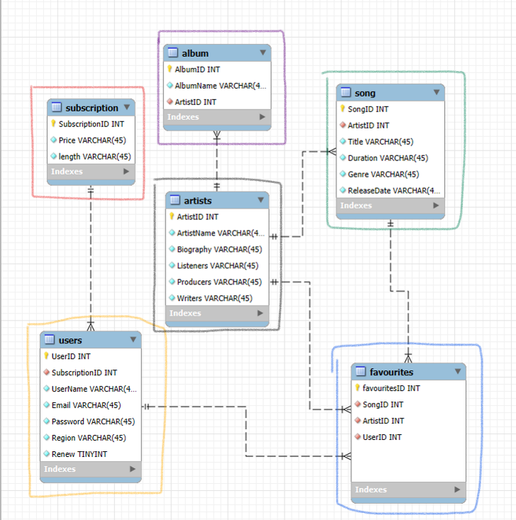

Table Run-through
Looking at the tables one by one will help us understand how they fit together. Refer to the larger schema to see how they connect with other tables. This relational database is equipped to handle extremely large quantities of relational data and is able to be queried using SQL and potentially ported to other software such as PowerBI.

Slide 5


Table Run-through
Subscription:
Composed of a primary key (SubscriptionID) and two fields for the price of the subscription and how long the subscription lasts. Very simplistic dimensional table.
Users:
Each user has their own name, email, password and region, combined with the Subscription Table’s foreign key and a value to check if it is on renewal. While these act as a baseline, you could also include payment details. Seeing how this contains confidential information, it is important to have security measures in place when using this as part of the whole relational database.

Slide 6


Table Run-through
Album:
Composed of a primary key (AlbumID) and two fields for the name of the album and the foreign key of artists that worked on them. In this case, there may be more than one album made by the same artist, hence why the artist – album relationship is 1-N (One-to-Many).
Artists:
Each artist has their own primary key and fields that would be presented on their profile in the app, including their biography, number of listeners and the producers they are linked with. This table has some significant links to the song and favourites table, acting arguably as a fact table for this star schema.

Slide 7

Table Run-through
Song:
Composed of a primary key, title, duration, genre and release date. Also contains an extremely important foreign key that links the song to the artist who made it. This allows us to run analysis on what songs are contributing most to an artist’s growth.
Favourites:
This table is comprised only of foreign and primary keys linking to the primary keys in the user, artist and song tables. This table is important as it allows us to track every user’s favourite song and the artist that made it. This information in turn can shed light on the preferences of the userbase based off their region, age etc.

Slide 8

Major Challenges
As a group, discussing the best approach for creating a database to suit our needs came with some challenges:
Our business would tread the lines of Big Data, so we needed to ensure we designed the schema with as little data redundancy as possible so it can handle potentially billions of data points Even the character limit for VARCHAR values can have a significant data size influence .
For the first time, we were making a database with the intention of data analysts using it rather than the other way around. We had to step into a data analyst’s mindset and think about what they could want to know about this music streaming business, designing our tables and relationships to facilitate this.

